Slide 1
DCH EMPLOYEE SCREENING APP

Slide 2
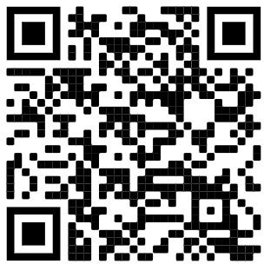
Welcome to the DCH Screening App for employees. Please use the following screen shots as a guide to use this screening tool.
Every employee is required to submit a screening at the beginning of every shift. **If you do not have a smartphone, you may complete a paper version. Copies are available at all clinics and both entrances to the hospital.
Follow these instructions to set up your profile and screen.
Point your phone camera at this QR code to scan

Slide 3
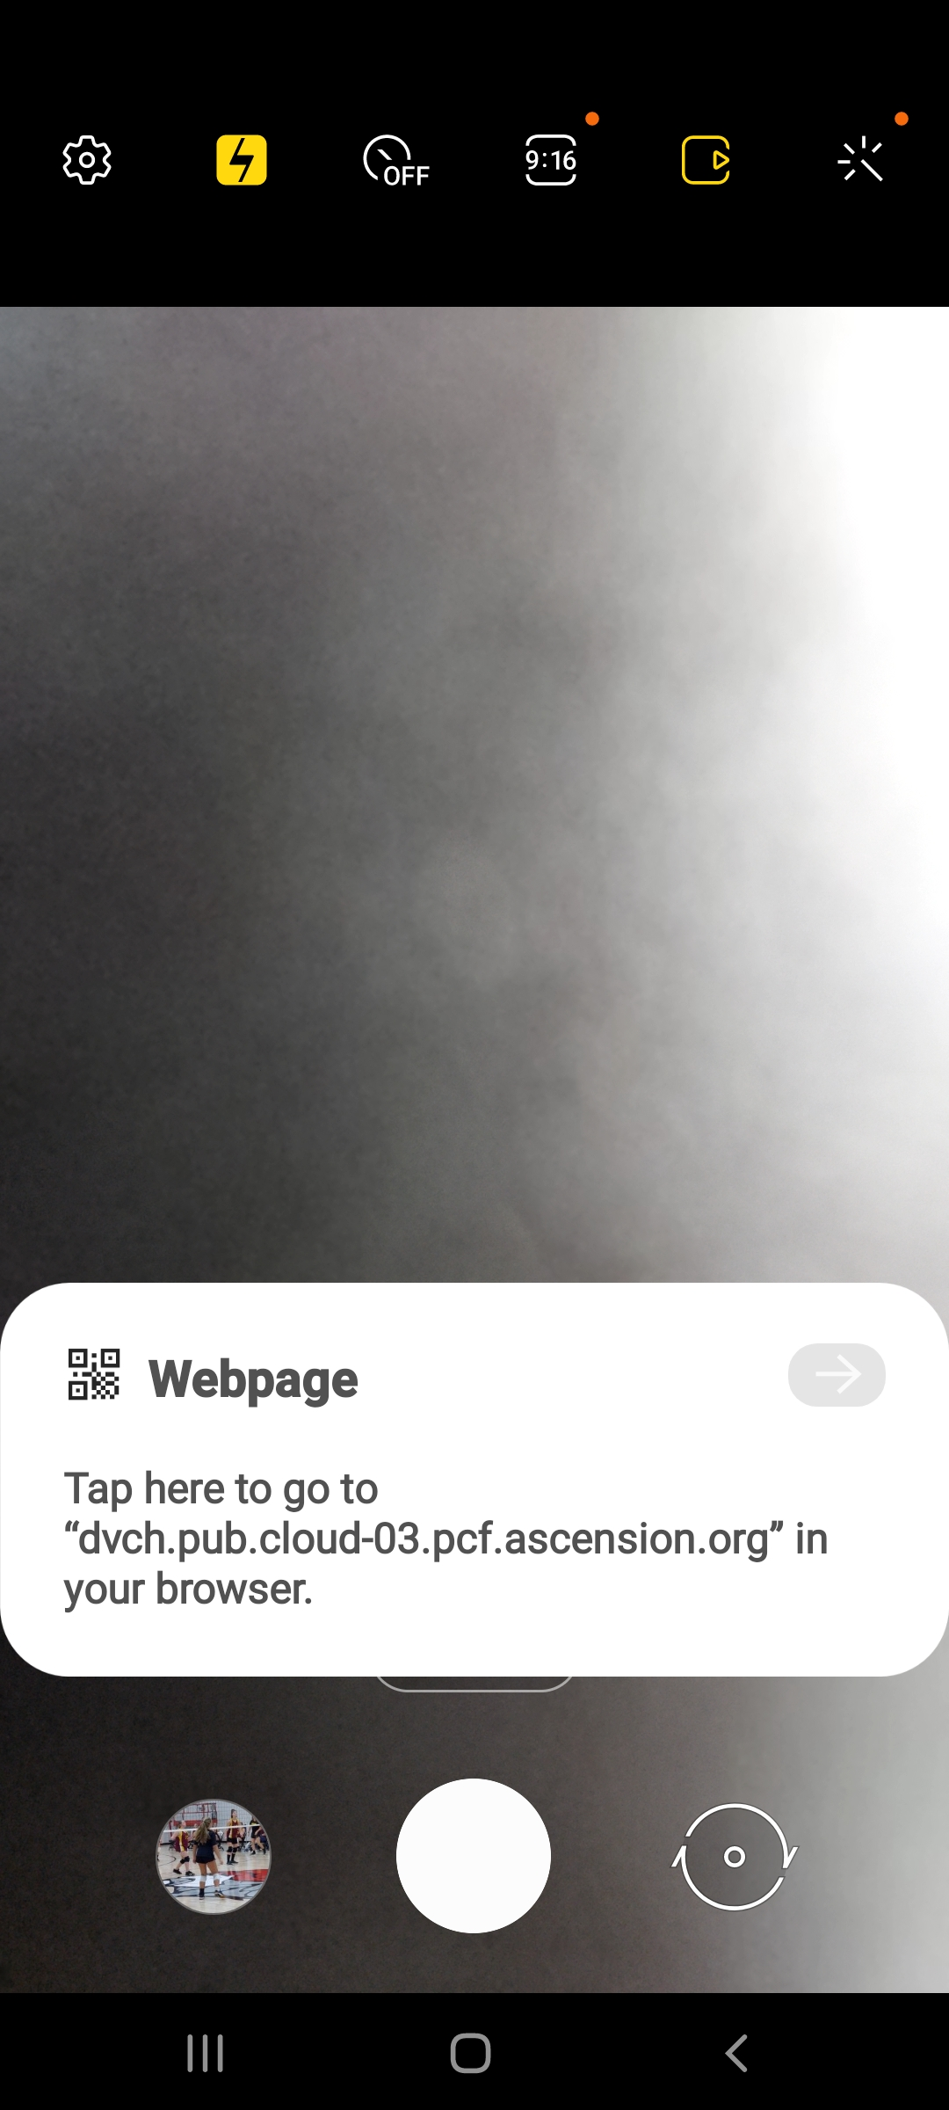

Slide 4
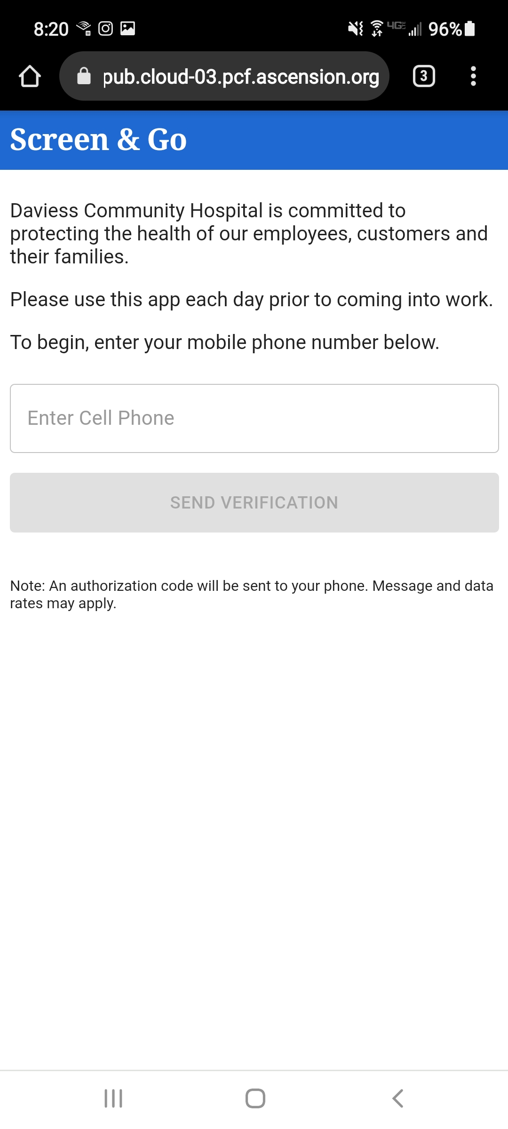

Slide 5
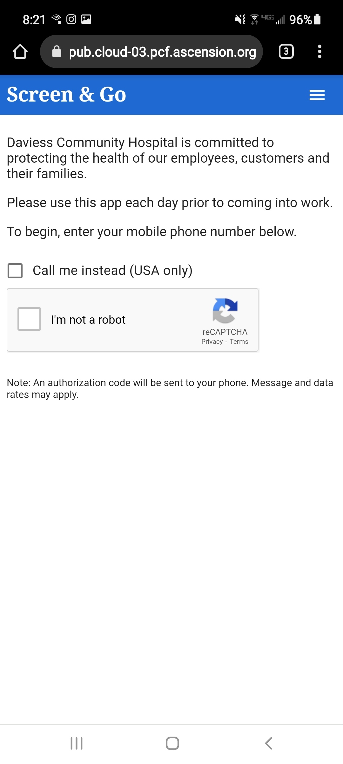
Check both boxes.

Slide 6
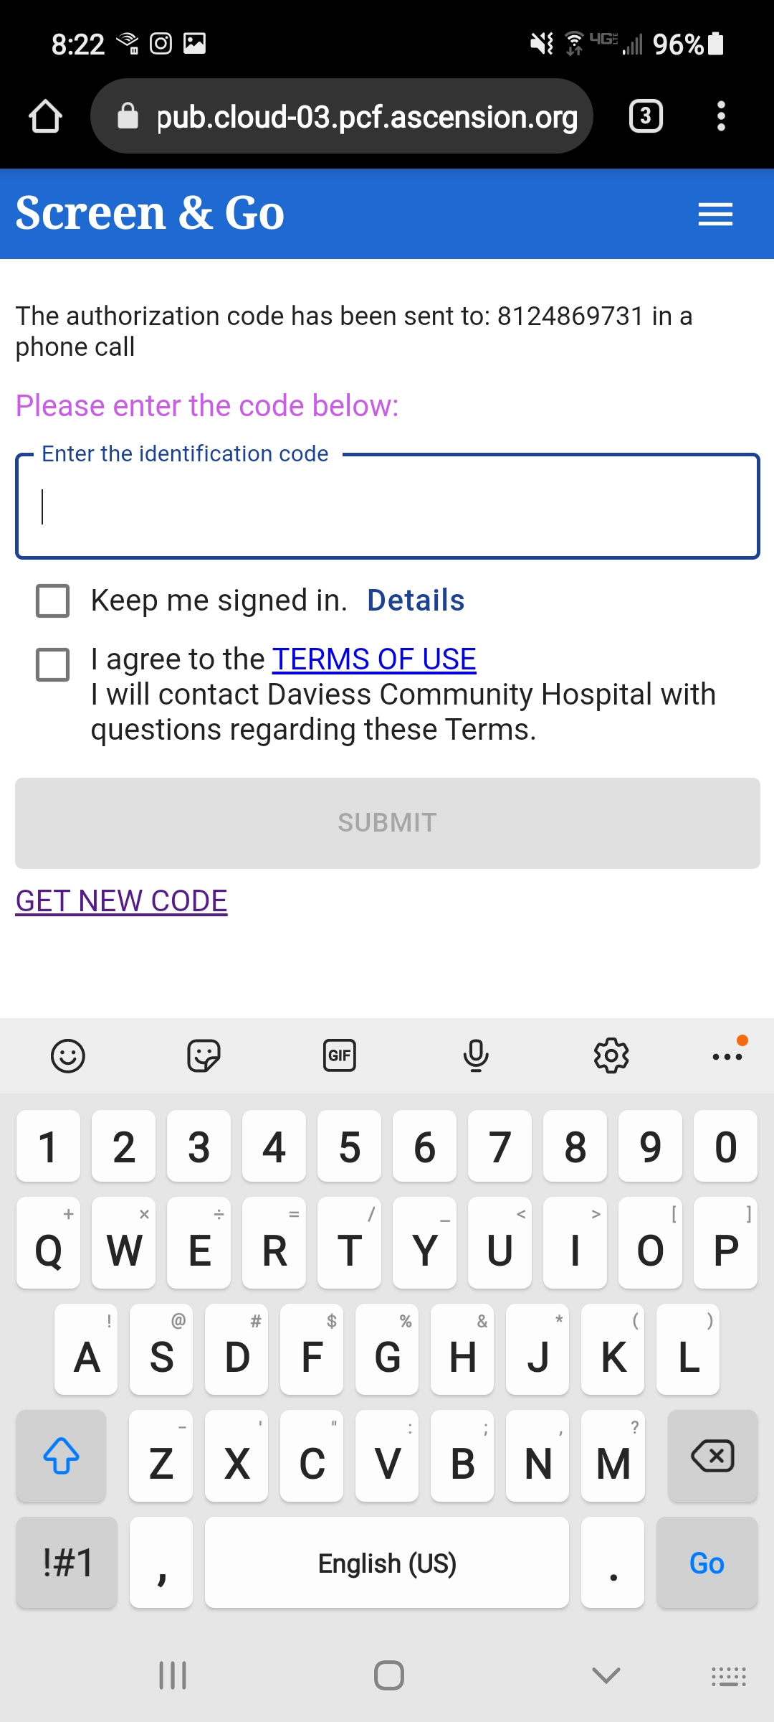
Check both boxes.

Slide 7
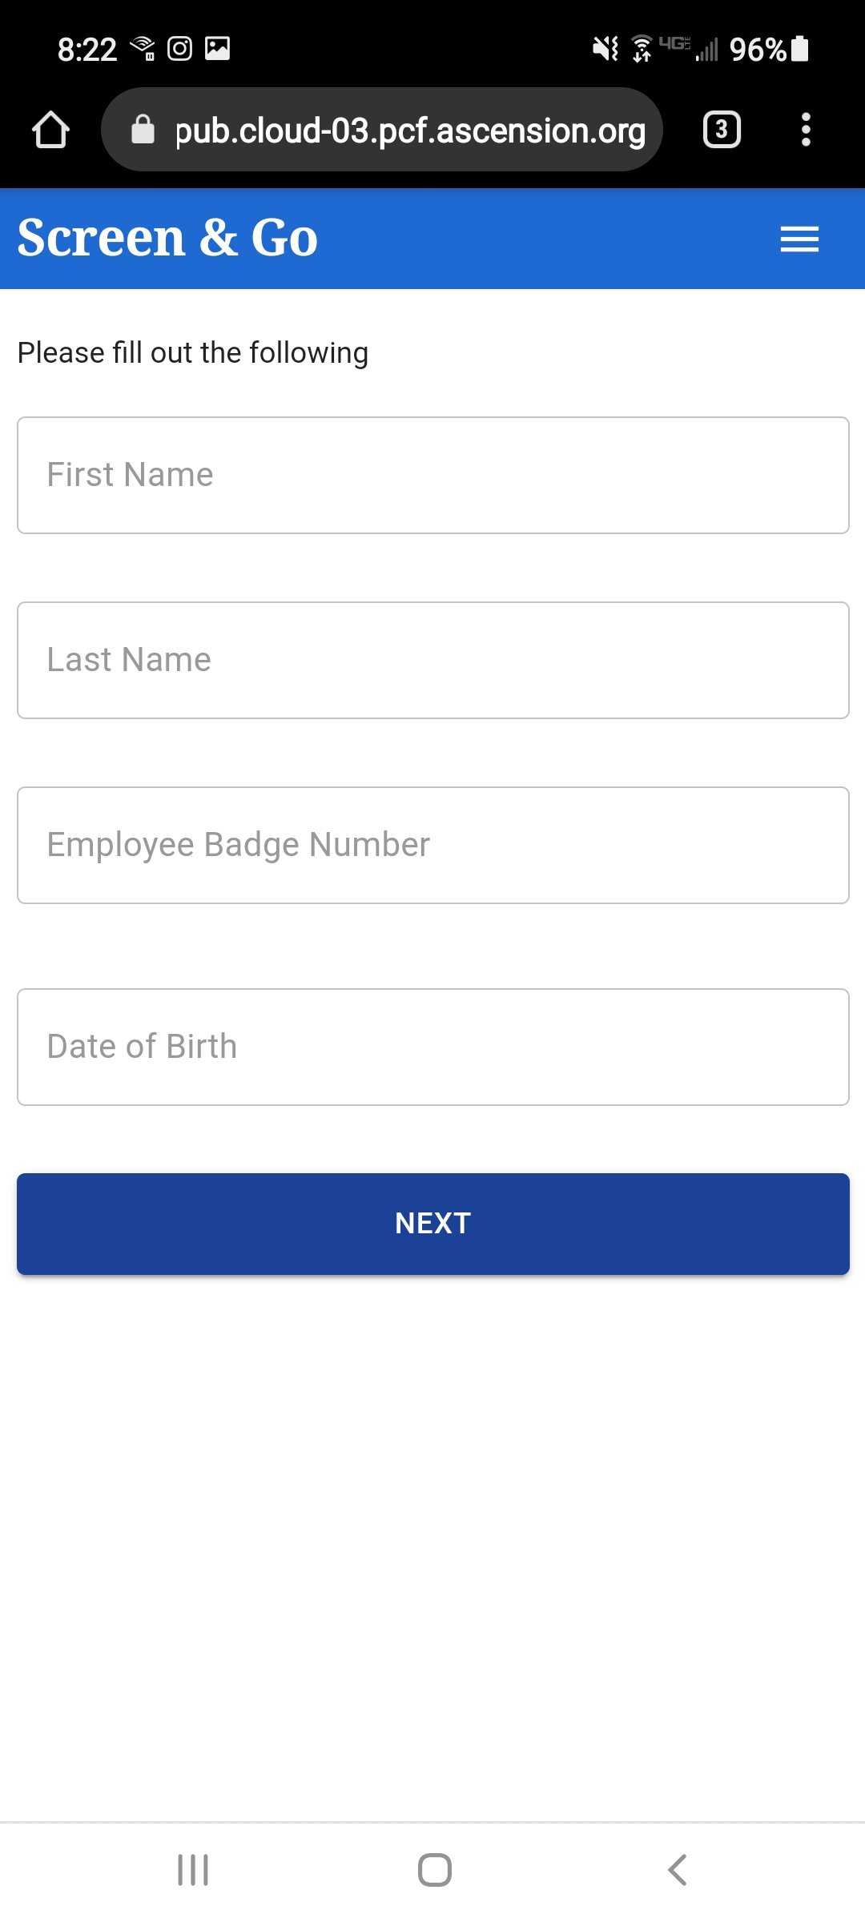

Slide 8
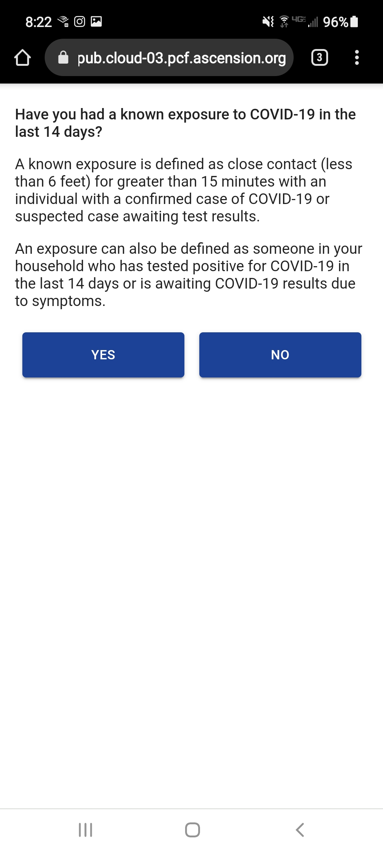

Slide 10
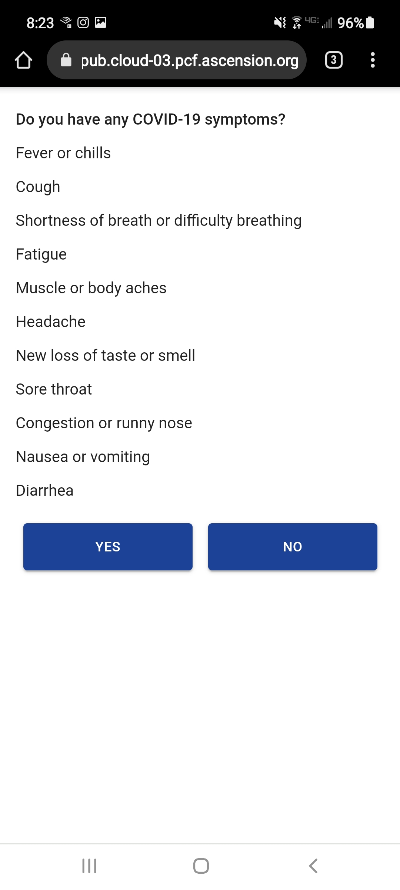

Slide 11
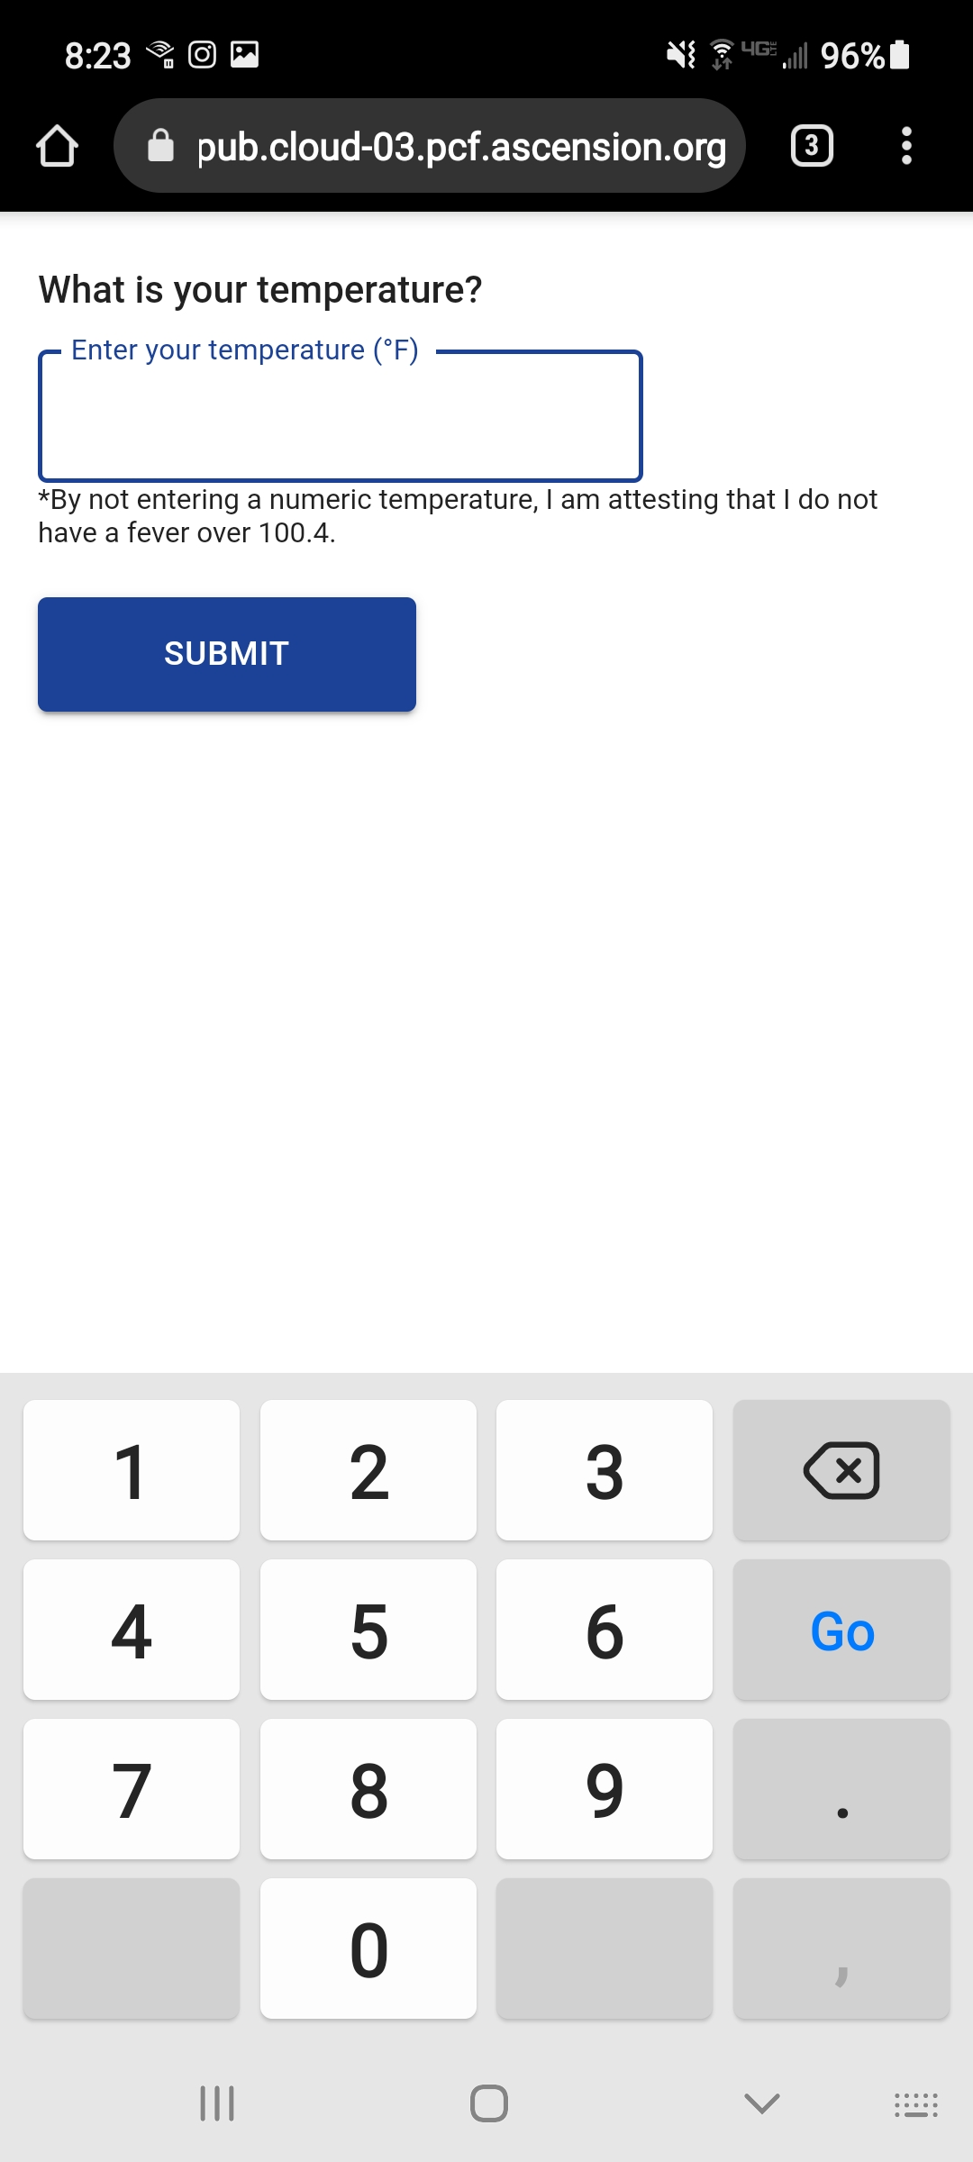

Slide 12
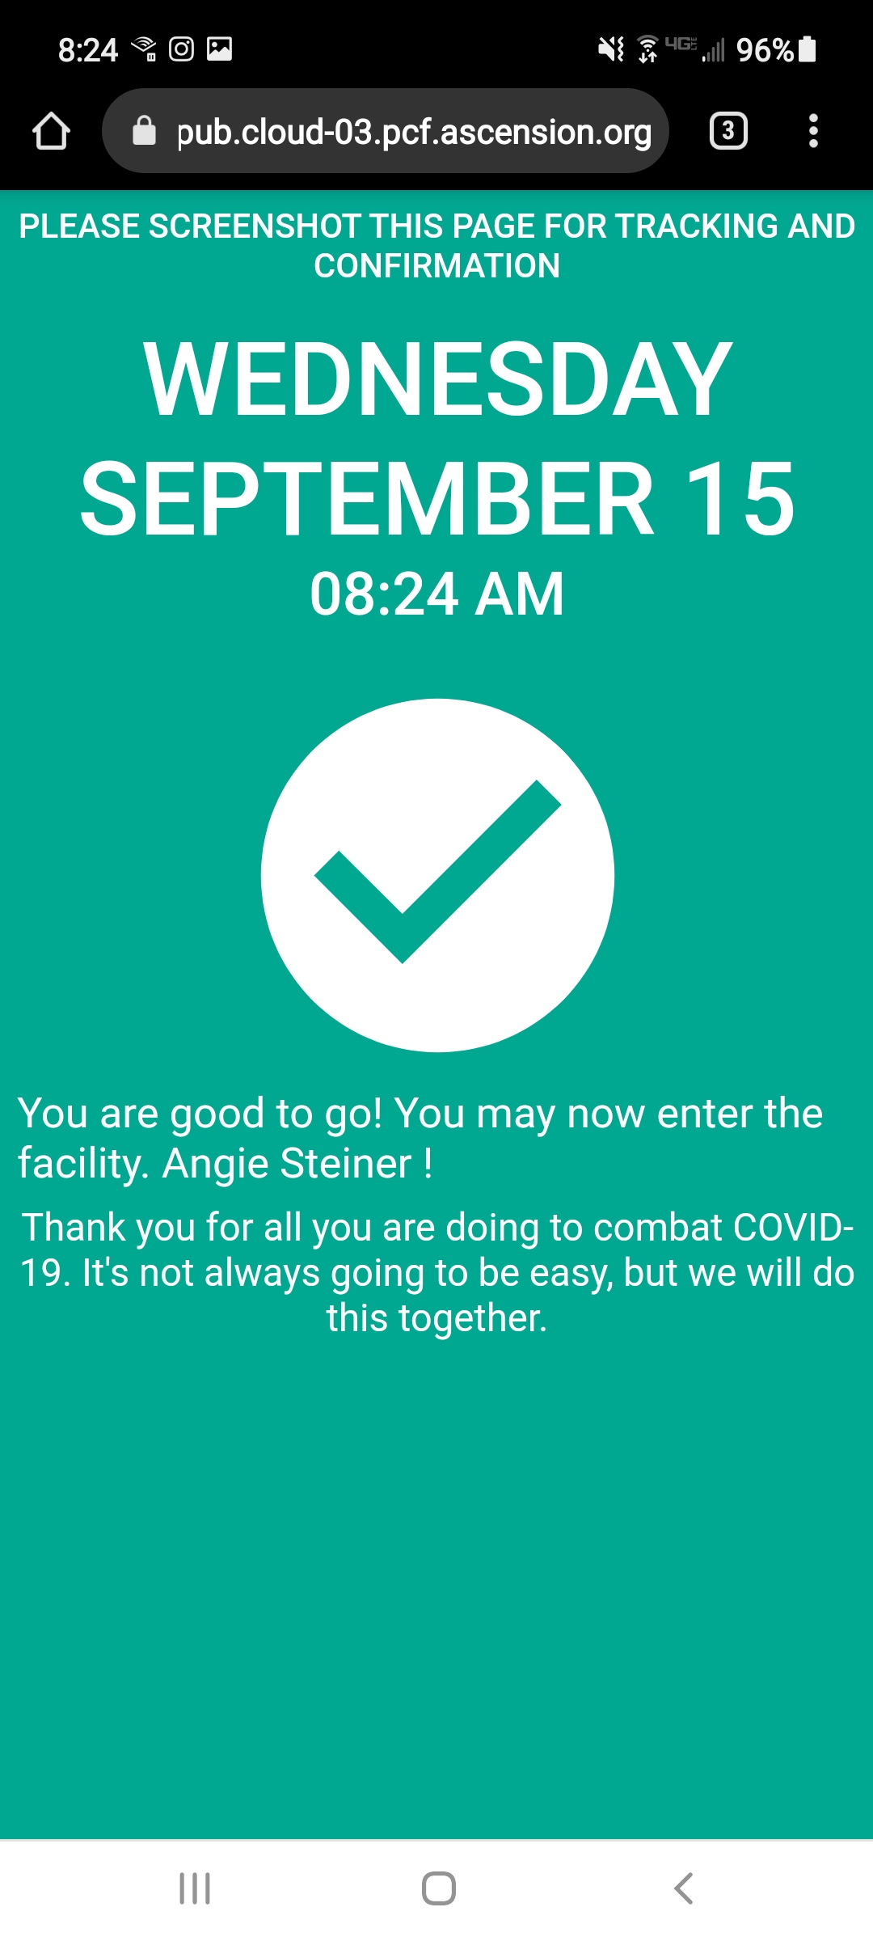
This is the screen you will see if you successfully pass the screening.
Once you have completed the initial setup, you may enter the following website and save as a “favorite” on your phone.
https://ui-ehfp-dvch.pub.cloud-03.pcf.ascension.org/
Your name

Slide 13
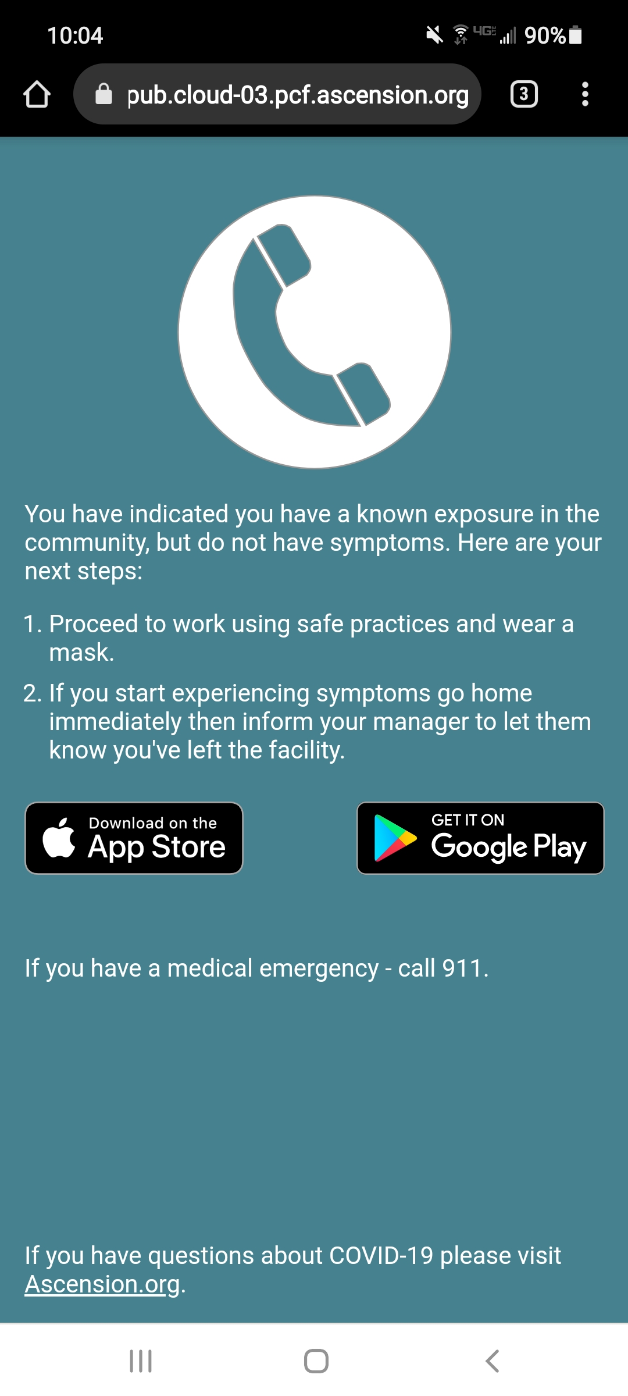
This is one of the screens you will see if you do NOT successfully pass the screening questions.
In this example, the employee answered “yes” to an exposure to someone with COVID in the community.
Please follow the instructions based on the results you see on the screen.

Slide 14
Frequently Asked Questions
Q: Are the employees only to screen themselves prior to a shift?
A: Correct. No one is required to screen after their shift begins or on days off.
Q: Who gets the results?
A: The results are uploaded into a database where DCH can run reports.
Q: Who does an employee show the “green check mark” to when they arrive?
A: The employee must present their “green screen” to either the volunteers at the front desk or the ED admitting desk (whichever entrance they enter).
Q: What if the employee does not get a “green screen” at the end?
A: The app will instruct the employee to contact their supervisor.
Q: Is there a different process for clinics vs. hospital staff?
A: No. All clinic employees will be required to complete the screening prior to entering their clinic and show proof to one another.
Q: What happens if someone does not self-screen?
A: They will be required to show proof of virtual screening at their entrance or they will be required to complete the paper screening form.

Slide 15
Laminated copies of the QR code for the clinics, front entrance and ED entrance will be posted no later than 9/18/21.
Paper copies for manual screening will be available at all clinics and in all hospital departments.
Questions? Please contact
Joe Gardner at Joseph.Gardner@medxcel.com or call 812-254-2760 ext 1182.

